Slide 1

The protocol master
Impossible testing at hand
Notes:
Hi, my name is Enrico Da Ros and this is “The Protocol Master, Impossible testing at hands”
Remove bin and obj from net-core projects
Loaded before all the docker images

Slide 2
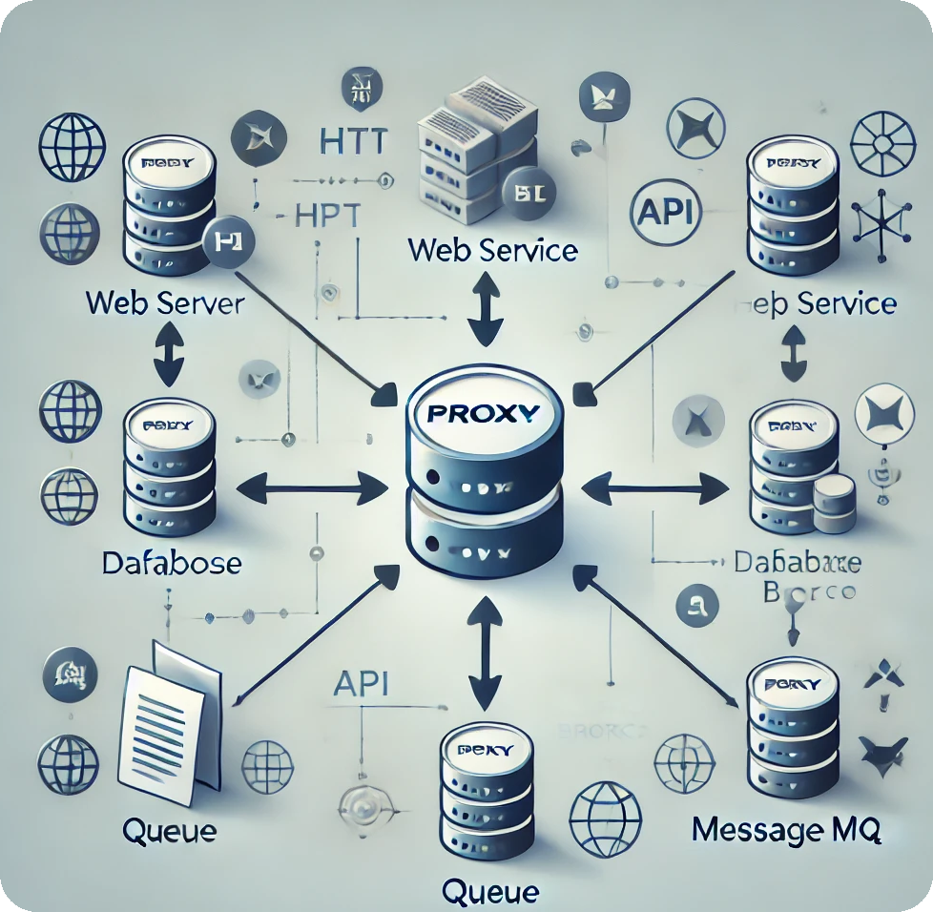
What THE TPM IS
The good man-in-the-middle
A Transparent Proxy
An Emulator
A Network Packet Analyzer
Notes:
What is The Protocol Master? TPM Is a Transparent Proxy, an Emulator and a Network Packet Analyzer, a simple command line Java application that can be placed between your software and all supported external system as a kind Man-In-The-Middle to log, record, replay and modify all the interactions. Following this approach, you can simulate a whole infrastructure without even coding.

Slide 3


There is already dev-proxy
Mocks, chaos engineering and simulated infrastructures
Simulate errors, rate limiting, responses
Mock entire infrastructures in minutes
Gold standard tests
Simulate non existing APIs
Protocols covered:
HTTP, HTTPS, Soap, REST
Notes:
Think about how much time is spent creating mocks for all your services, setting up fake databases or external service. What happens when the underlying QA data changes and the entities your test were based on are no more available. How can you create Integration Tests involving queues when you do not want to interact with the real infrastructure.
Another common situation is when an API does not exist yet and you need to verify its interactions. Or when you want to check what happens in “extreme situations”, with a Chaos Engineering approach, like when a service is slow or is limited via throttling. What happens when an unexpected HTTP error code is received, or the wrong data is returned from the storage.
For http interactions you can find already some product like Microsoft dev-proxy but what about the rest. With TPM instead you can handle a bunch of protocols and scenarios.
You can easily create “Gold standard” tests to avoid regressions, only one run can be used an infinite number of times

Slide 4

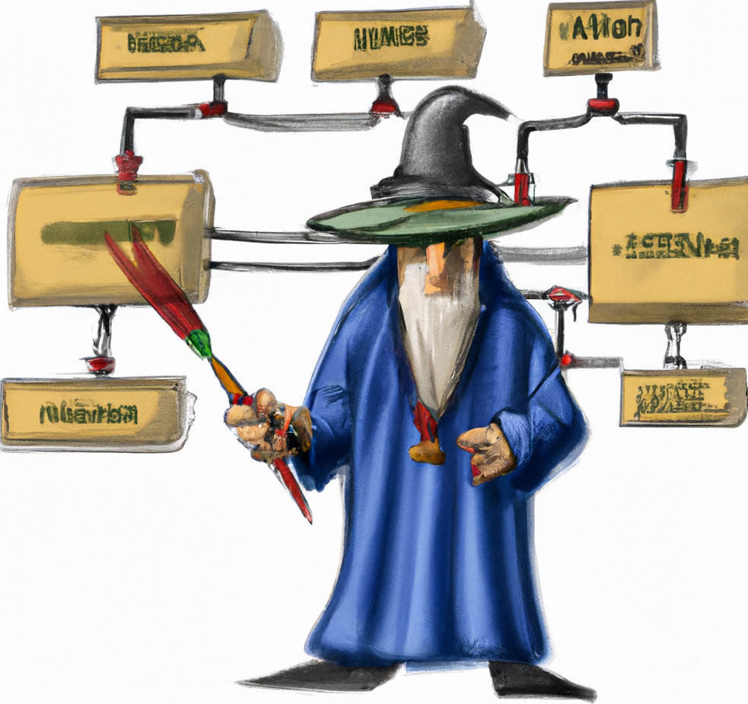



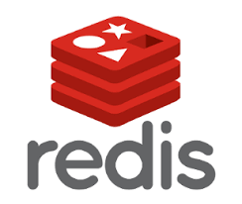




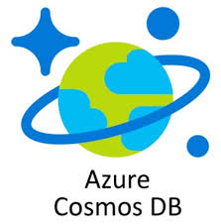





But with TPM you have this too…
MySQL, Postgres, Mongo Db, Redis
AMQP 0.9, MQTT (next in line: Kafka)
Upload complete “scenes”

Slide 5













WHERE CAN be run
Hint: Mostly everywhere, it’s wire protocol ☺
Agnostic in respect of
Language
Infrastructure
Architecture
Run as
Command line
Docker image
Kubernetes
CI/CD Integration
Embedded in Java
Notes:
You can do all of this with TPM and you can do this with your preferred system and architecture.
The system can run locally via command line (leveraging its internal a proxy to record http calls from a browser) or as a Docker image. You can event integrate it in your CI/CD pipeline. All without caring about the Language/Infrastructure/Architecture since the emulation is built upon the –real- wire protocol used by the services emulated.
There will be no difference between calling TPM or a real server. The language spoken is raw TCP data, no need for weird AOP techniques, custom drivers (been there done that…never again). Just use the TPM as a unique entry point exposing all the services you need.

Slide 6
DEMO TIME!

Slide 7
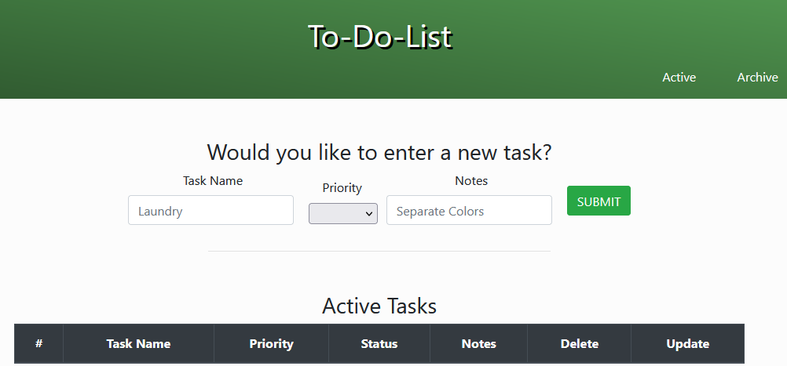
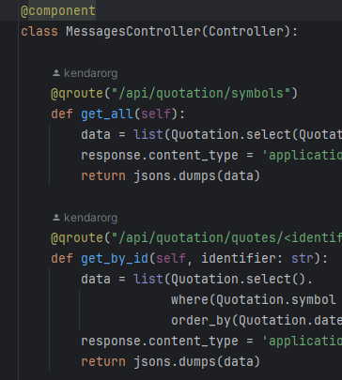
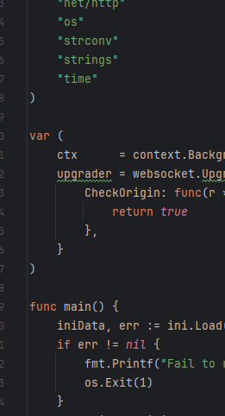
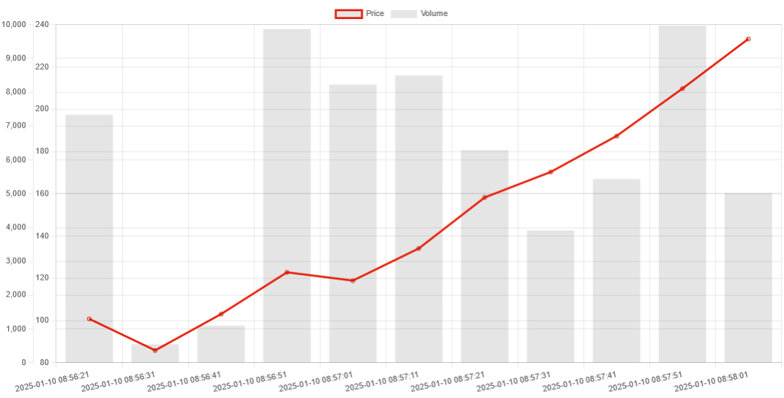
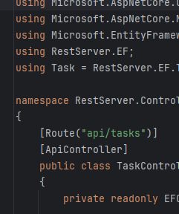
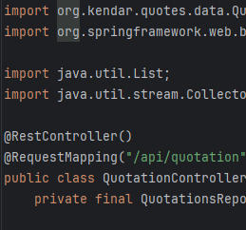
Multiplatform verified
Python/MySQL/RabbitMQ
Java/Spring/MySQL/MQTT
Golang/Redis/Postgres
.NET/Entity Framework/MySQL
Notes:
You can download a bunch of demo servers from https://github.com/kendarorg/the-protocol-master-samples
Various languages are present here s: NET, Java, Python and Golang, to let you get how easy is to integrate it in your development process

Slide 8
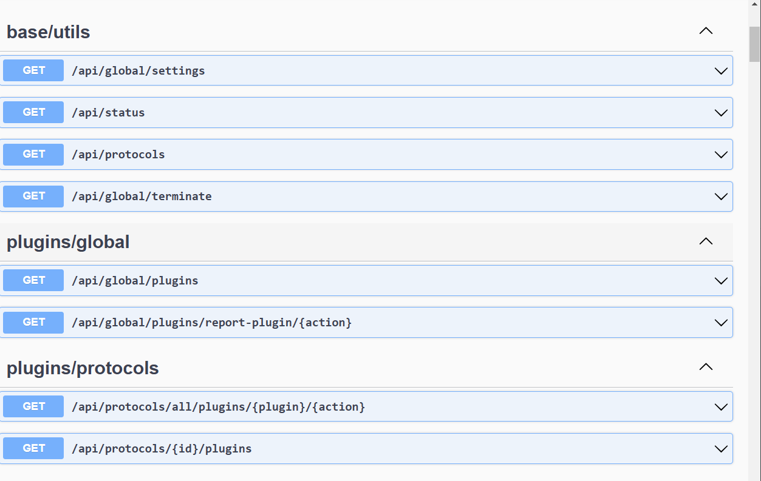
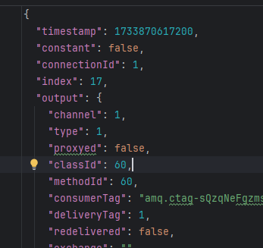
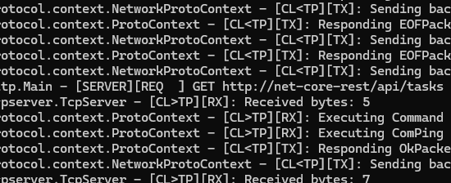
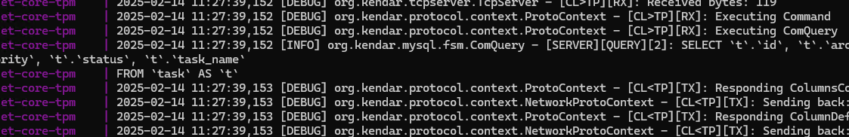
The first approach*
*fear not the power ☺
Notes:
Let’s start with the docker-compose of the NET project,
We will run it on Docker
Start net-core/docker-compose.yml
Configure the browser to use the proxy [DOCKER_HOST]:9000
You can explore the APIs exposed by TPM but first we should install the SSL root certificate in our browser
Install the certificate http://localhost:8081/swagger-ui/index.html
Navigate to https://www.google.com and show the “root-cert” fake certificate
Here we are exposing two protocols: http and MySQL, each with its set of “plugins” that can interact with the communications with our real server
We can look at the settings used by this instance: http://localhost:8081/api/global/settings

Slide 9
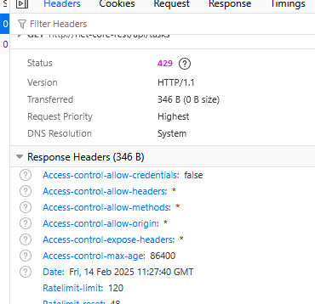
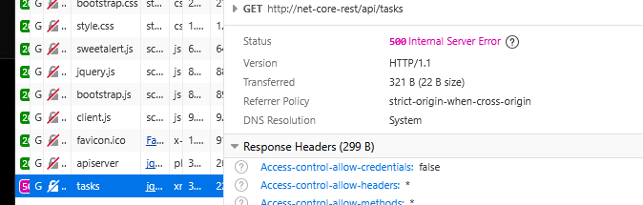
.net core todo application*
*with chaos included
Tech stack:
.net Core
Entity Framework
MySQL
Notes:
This is a simple “todo” application to demonstrate the handling of MySQL, and HTTP communications.
I will demonstrate you some “Chaos engineering” testing
Navigate to http://net-core-http/index.html
Start the debugging on the web browser
Insert a To-Do, progress it to completed and then archive and delete
Now we will try some chaos engineering
Latency
Check the settings for the http latency plugin: http://localhost:8081/api/protocols/http-01/plugins/latency-plugin/settings
You can see I set a regular expression to define what APIs the plugin will affect
Enable the plugin http://localhost:8095/api/protocols/http-01/plugins/latency-plugin/start
Notice the latency of the response
Disable the plugin http://localhost:8095/api/protocols/http-01/plugins/latency-plugin/stop
Error
Check the settings for the http error plugin: http://localhost:8081/api/protocols/http-01/plugins/error-plugin/settings
You can see I set a regular expression to define what APIs the plugin will affect
The error should appear on 70% of API calls
Enable the plugin http://localhost:8095/api/protocols/http-01/plugins/error-plugin/start
Notice the random errors
Disable the plugin http://localhost:8095/api/protocols/http-01/plugins/error-plugin/stop
Throttling
Check the settings for the http error plugin: http://localhost:8081/api/protocols/http-01/plugins/rate-limit-plugin/settings
You can see I set a regular expression to define what APIs the plugin will affect
Open the http://net-core-rest/api/tasks api
Enable the plugin http://localhost:8095/api/protocols/http-01/plugins/rate-limit-plugin/start
Refresh furiously to simulate the need for throttling
See the 429!
Disable the plugin http://localhost:8095/api/protocols/http-01/plugins/rate-limit-plugin/stop

Slide 10
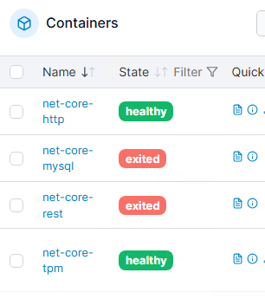
.net core todo application*
*NO SERVERS INCLUDED!
Tech stack:
.net Core
Entity Framework
MySQL
Notes:
Here we can try a full recording of the application interactions
Show the settings for http record plugin http://localhost:8081/api/protocols/http-01/plugins/record-plugin/settings
Show the settings for MySQL http://localhost:8081/api/global/settings
Notice how we defined the proxied server connection, this is where we will retrieve the data
Start the recording on all plugins http://localhost:8081/api/protocols/all/plugins/record-plugin/start
Force refresh the http://net-core-http/index.html page
Insert a To-Do item
Move it to completed
Archive the item
Check its presence on the “archive” tab
Stop the recording on all plugins http://localhost:8081/api/protocols/all/plugins/record-plugin/stop
You can now explore all the calls made by the application
Explore the data recorded: http://localhost:8081/api/global/storage/items?maxLength=100
Explore a specific response item: http://localhost:8081/api/global/storage/items/mqtt-01/0000000009
Look Ma, no Database server
Stop the MySQL server docker image (I’ll use portainer http://192.168.1.96:9000/#!/2/docker/stacks )
Start the MySQL replay plugin http://localhost:8081/api/protocols/mysql-01/plugins/replay-plugin/start
Force refresh the http://net-core-http/index.html page
Insert a To-Do item
Move it to completed
Archive the item
Check its presence on the “archive” tab
Stop the MySQL replay plugin http://localhost:8081/api/protocols/mysql-01/plugins/replay-plugin/stop
Look Ma, no APIs
Stop the net-core-rest server docker image (I’ll use portainer http://192.168.1.96:9000/#!/2/docker/stacks )
Start the http replay plugin http://localhost:8081/api/protocols/http-01/plugins/replay-plugin/start
Force refresh the http://net-core-http/index.html page
Insert a To-Do item
Move it to completed
Archive the item
Check its presence on the “archive” tab
Stop the MySQL replay plugin http://localhost:8081/api/protocols/http-01/plugins/replay-plugin/stop

Slide 11
THE Java stock quotes application…
…and the missing queue
Tech stack:
Spring Boot
MQTT
JPA
MySQL
Notes:
In this demo we will simulate a MQTT broker inside a Java application with asynchronous calls, and what happens when we send a “broken” message to our application
The application consist of a UI that show fake stock quotes data and a quotes sender application
In this demo we will use a local instance for TPM and the java backend, while the MySQL, MQTT broker and quotes generator will be on Docker
Start java/docker-compose.yml
Explore the TPM settings for this situation
Start TPM with the correct settings ( java –jar protocol-runner.jar –cfg simple-settings.json
Open the java-rest project on IntellijIdea and explain the application.properties
Start the java-rest
Explore the quotations http://java-rest/index.html and see the quotations changing (every 10 seconds)
Now let’s start recording
Navigate to the TPM local server http://localhost:8081/swagger-ui/index.html
Start the MQTT recording http://localhost:8081/api/protocols/mqtt-01/plugins/record-plugin/start
Navigate to the chart, refresh it and wait for 5/6 quotes to appear
Stop the MQTT recording http://localhost:8081/api/protocols/mqtt-01/plugins/record-plugin/stop
Explore the data recorded: http://localhost:8081/api/global/storage/items?maxLength=100
Explore a response item: http://localhost:8081/api/global/storage/items/mqtt-01/0000000009
Mark the timestamp of the created item
Stop the quote-generator
Navigate to http://java-rest/swagger-ui/index.htm and clean all quotations
Let’s replay
Start the MQTT replay plugin http://localhost:8081/api/protocols/mqtt-01/plugins/replay-plugin/start
Look the quotations appearing
Stop the MQTT replay plugin http://localhost:8081/api/protocols/mqtt-01/plugins/replay-plugin/start
Let’s send a broken message
Navigate to http://java-rest/swagger-ui/index.htm and clean all quotations
Start the MQTT publish plugin http://localhost:8081/api/protocols/mqtt-01/plugins/publish-plugin/start
Look the MQTT connections http://localhost:8081/api/protocols/mqtt-01/plugins/publish-plugin/connections
Send a message with the following content, and the timestamp taken before
{
"contentType": "application/json",
"body": "{\"symbol\":\"META\",\"date\":1737495412037,\"price\":400,\"volume\":4000}",
"topic": "quotations"
}
Now the chart has a new item!
Send a message with the following content, and the timestamp taken before
{
"contentType": "application/json",
"body": "{\"symbol\":\"META\",\"date\":\“WRONGVALUE\",\"price\":400,\"volume\":4000}",
"topic": "quotations"
}
Look the error on the rest server log!

Slide 12
LET’s go deeper

Slide 13

Other features
If you missed them!
Java Plugin based
Event based architecture
Mock specific requests
Rewrite request responses
Expose internal APIs
Intercept even SSL communications
Internal Proxy (with WebSocket support)
“All is JSON” approach
78% code coverage
Notes:
The whole system is plugin-based, you can create Java 17 jars to intercept specific request/response and act on the whole communication pipeline
The application provides an event system to intercept the “reporting events” to detect executions, calls and create custom reports
It is possible to mock specific requests (1 or more times, or after a certain amount of executions)
All the http and DB request/response can be “redirected” you can for example let “http://url/path” to anything else or using an Oracle data source for Grafana as if it where a Postgres Database (this is a Postgres-specific function)
TPM as you have seen exposes its own REST APIs to interact with simple calls, for example to setup automated tests
It can run most functions from command line
It can intercept the access to https resources, for example you can use it as a proxy for a phone and, after adding the root certificate, verify all calls made by the phone
All is JSON approach. To ease readability

Slide 14


Find out more
http://www.github.com/kendarorg
https://www.linkedin.com/in/enricodaros/
enrico.daros@gmail.com
https://www.kendar.org
Notes:
And here my details:
http://www.github.com/kendarorg
https://www.linkedin.com/in/enricodaros/
enrico.daros@gmail.com
https://www.kendar.org

Slide 15

Thanks to everybody
Now go with the Q&A
… AND it’s not DEV-PROXY
Notes:
Question time!

